Slide 1
Group 9 Sludge particles detections
Hồ Quang Minh
Đỗ Đặng Minh (nhóm trưởng)
Huỳnh Công Toàn
Dương Xuân Long
Hồ Văn Tấn

Slide 2
Strategy
Detect metal particles:
F1 filter, near focus image, P3N.bmp
Convert original image to grayscale image
Apply threshold (80) to enhance metal particles
Apply dilation & erosion operator (size = 5) to reduce noise
After this step, we have the metal mask
Apply the metal mask to the original image

Slide 3
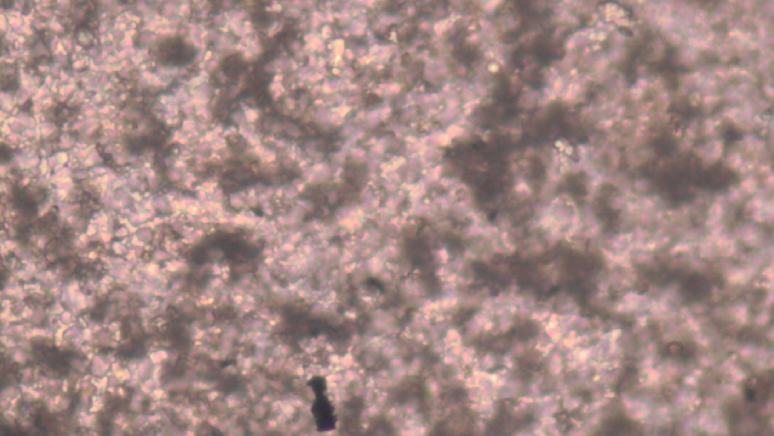
ORIGINAL

Slide 4
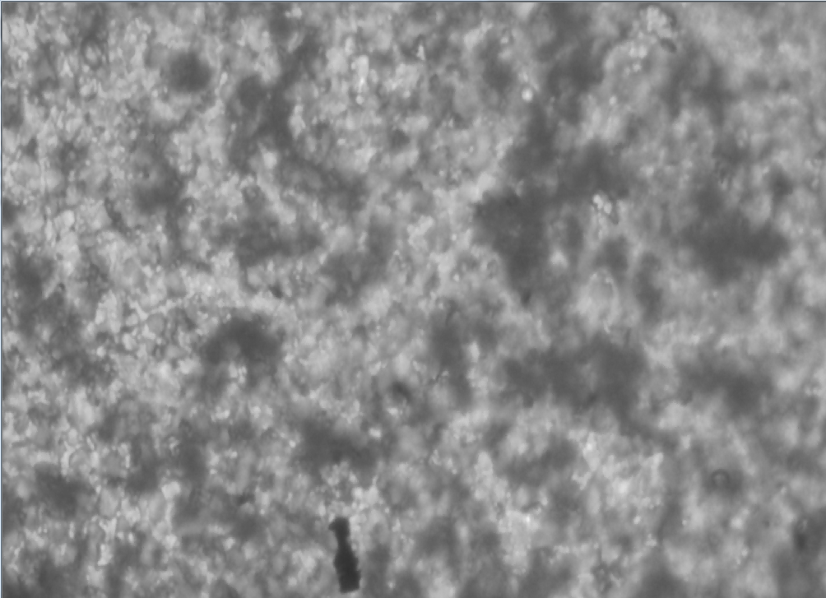
GRAYSCALE

Slide 5
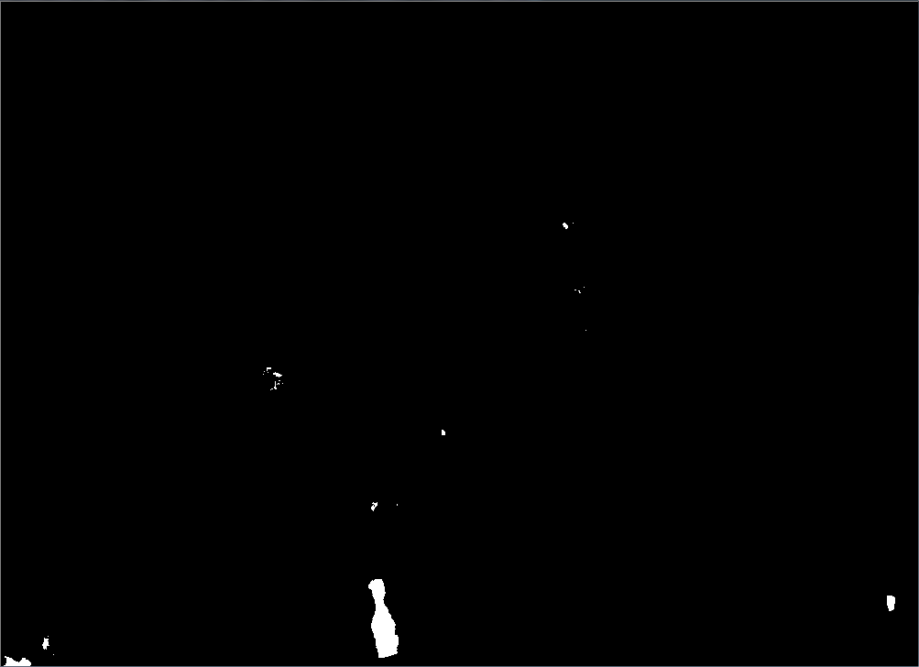
THRESHOLD (80)

Slide 6
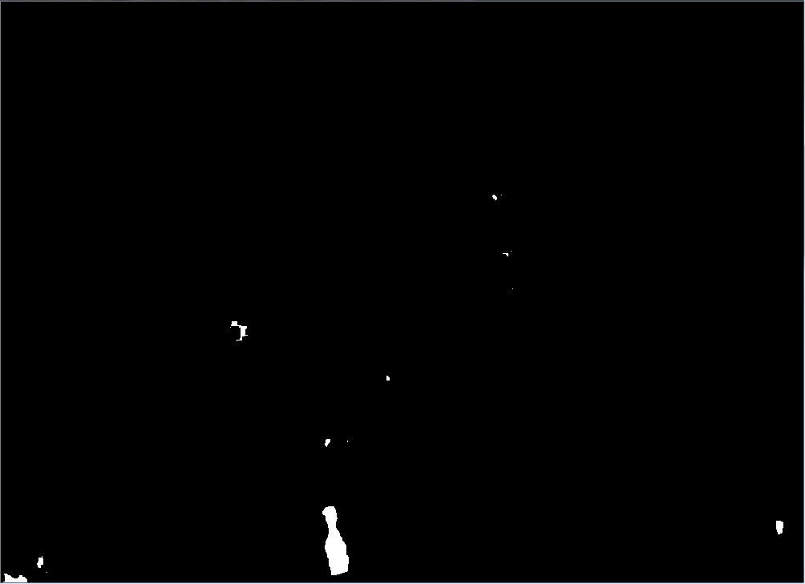
MORPHOLOGY (5)

Slide 7
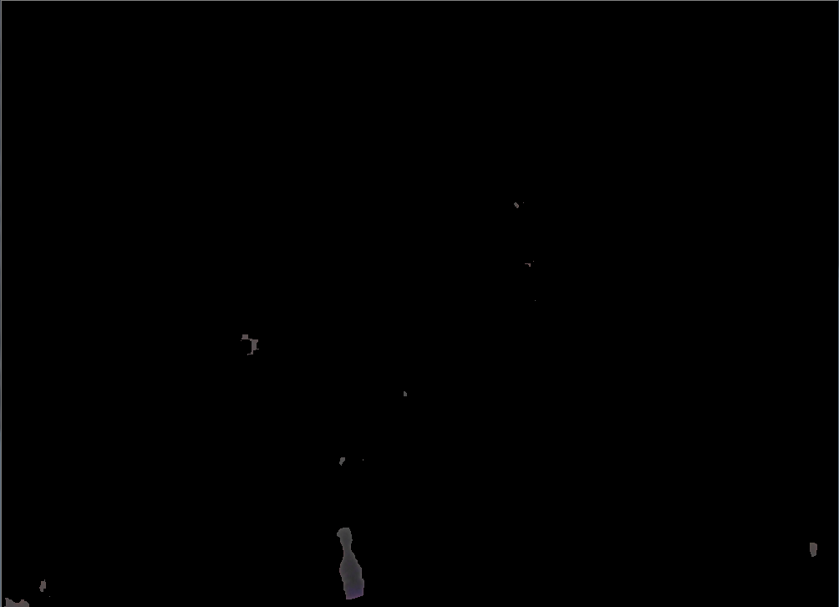
METAL DETECTION

Slide 8
Strategy
Detect powder particles:
F1 filter, near focus image, P3N.bmp
Convert original image to grayscale image
Apply threshold (130) to enhance powder particles
Apply dilation & erosion operator to reduce noise
After this step we have the powder-metal mask
Substract metal mask from powder-metal mask
After this step we have the powder mask
Apply the powder mask to the original image

Slide 9
ORIGINAL

Slide 10
GRAYSCALE

Slide 11
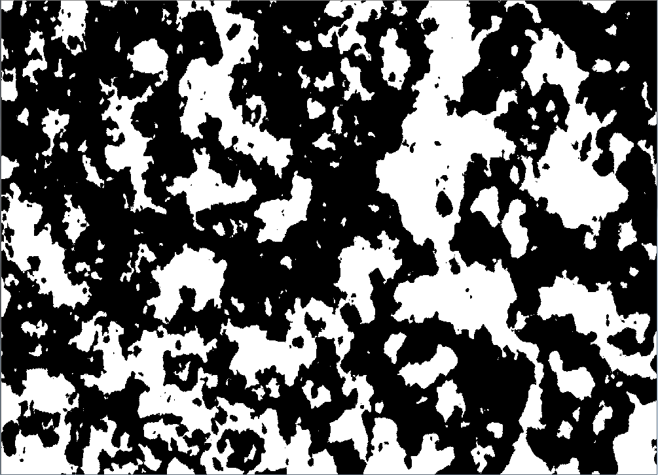
THRESHOLD (130)

Slide 12
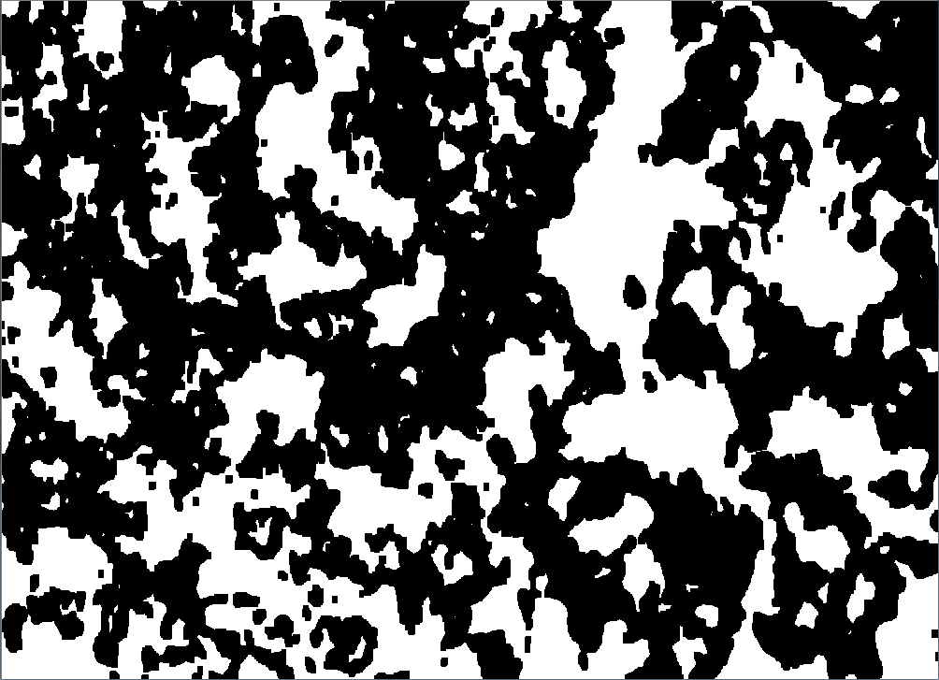
MORPHOLOGY (5)

Slide 13
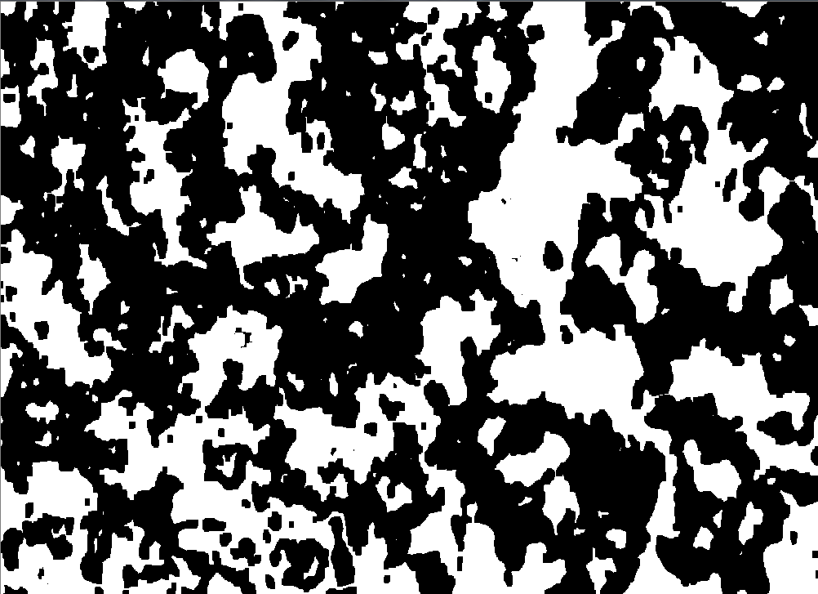
Subtract metal mask

Slide 14
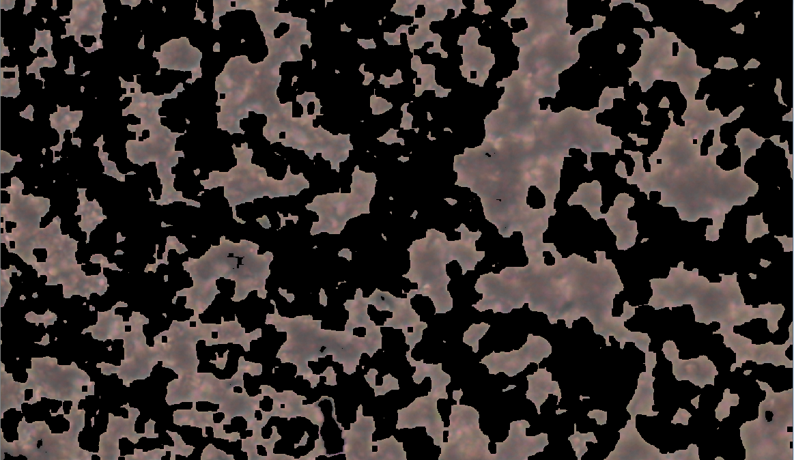
POWDER DETECTION

